Slide 1
1_TO SITE_Слайд-3
Notes:
textbox
No alt text provided
Сума кредитних договорів
No alt text provided
kpi
No alt text provided
приріст, %
No alt text provided
приріст, %
No alt text provided
приріст, %
No alt text provided
приріст, %
No alt text provided
slicer
No alt text provided
Total-Приріст
No alt text provided
Підписані КД (млн. грн.)
No alt text provided
image
No alt text provided
Поточна заборгованість
No alt text provided
30.05.2022
No alt text provided
image
No alt text provided

Slide 2
2_TO SITE_Слайд-5
Notes:
textbox
No alt text provided
ТОП 10 банків (млн. грн.)
No alt text provided
slicer
No alt text provided
FRP_logo
No alt text provided
card
No alt text provided
Інвестиційна ціль (млн. грн.)
No alt text provided
card
No alt text provided
Антикризова ціль (млн. грн.)
No alt text provided
card
No alt text provided
Рефінансування (млн. грн.)
No alt text provided
textbox
No alt text provided
UGB_logo
No alt text provided
Oschad_logo
No alt text provided
CAU_logo
No alt text provided
Aval_logo
No alt text provided
Aval_logo
No alt text provided
KredoBank_logo
No alt text provided
Pumb_logoR
No alt text provided
Aval_logo
No alt text provided
Pumb_logoA
No alt text provided
CAU_logo
No alt text provided
KredoBank_logo
No alt text provided
Oschad_logo
No alt text provided
UGB_logo
No alt text provided
Privat_logo
No alt text provided
image
No alt text provided
image
No alt text provided
image
No alt text provided
Oschad_logo
No alt text provided
KredoBank_logo
No alt text provided
image
No alt text provided
image
No alt text provided
image
No alt text provided
Privat_logo
No alt text provided
Privat_logo
No alt text provided
30.05.2022
No alt text provided
image
No alt text provided
Pumb_logoR
No alt text provided

Slide 3
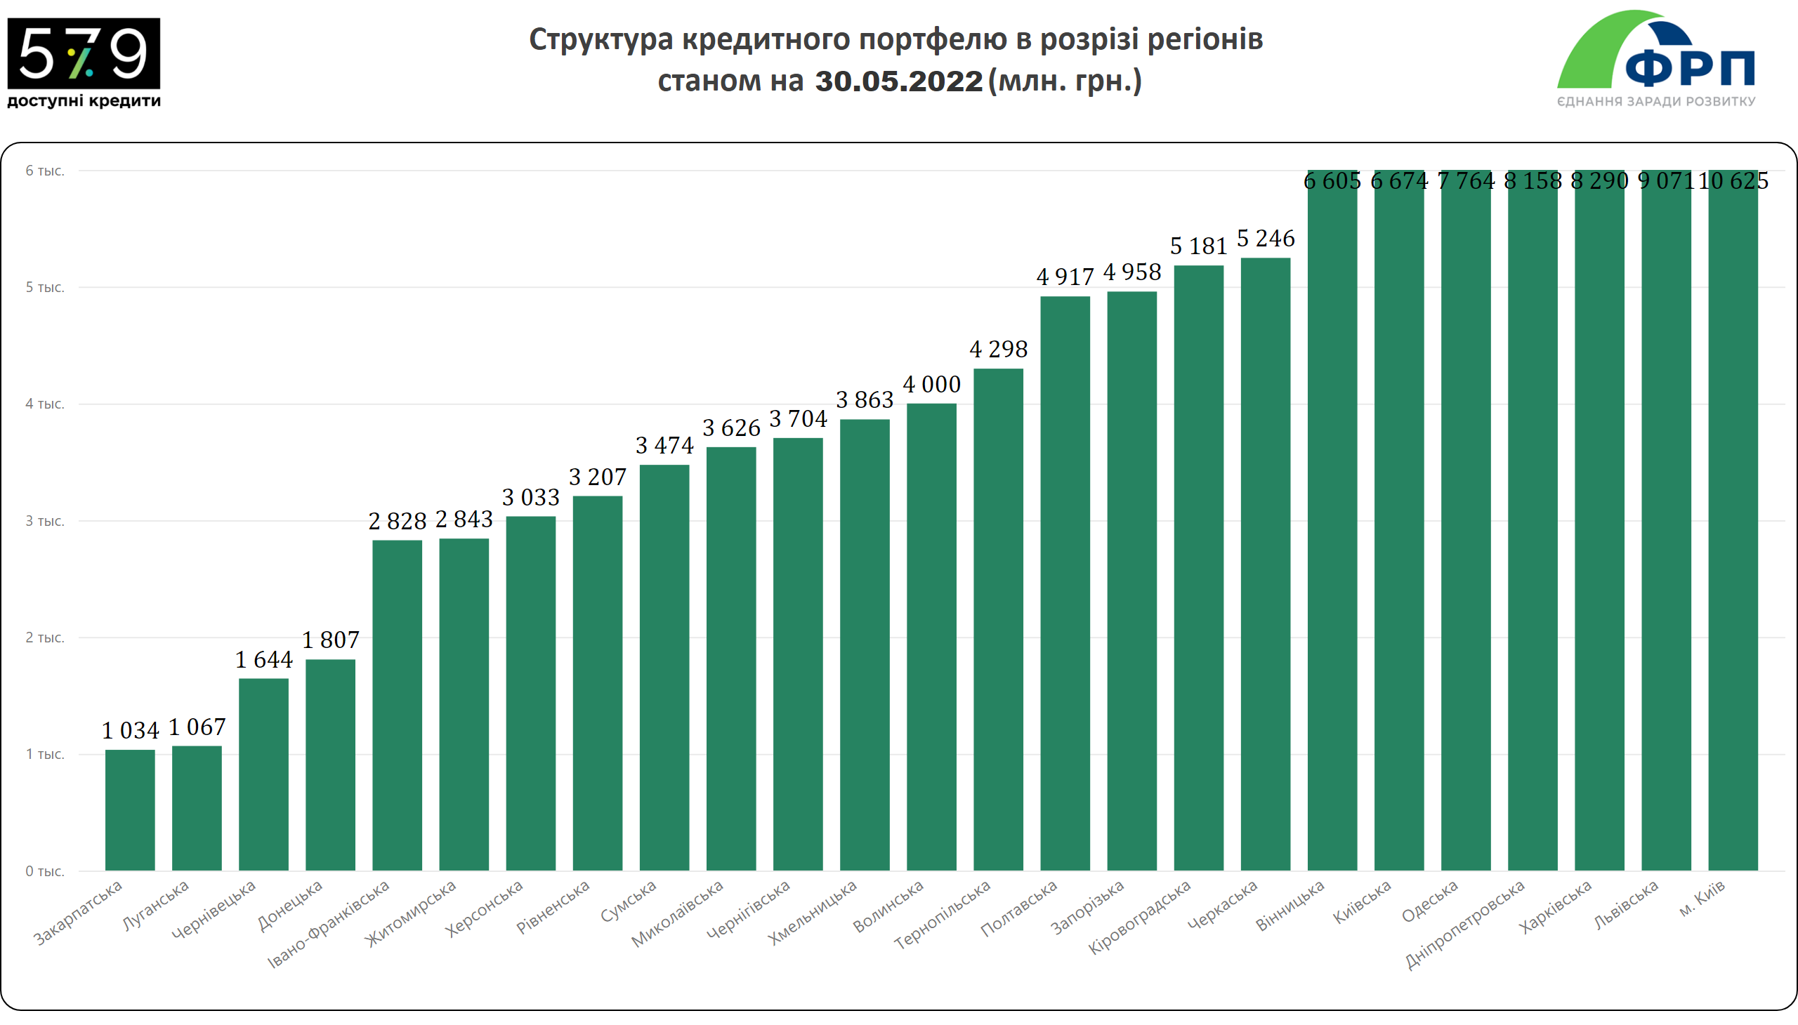
4_TO SITE_Слайд-7
Notes:
textbox
No alt text provided
columnChart
No alt text provided
slicer
No alt text provided
FRP_logo
No alt text provided
30.05.2022
No alt text provided
image
No alt text provided

Slide 4
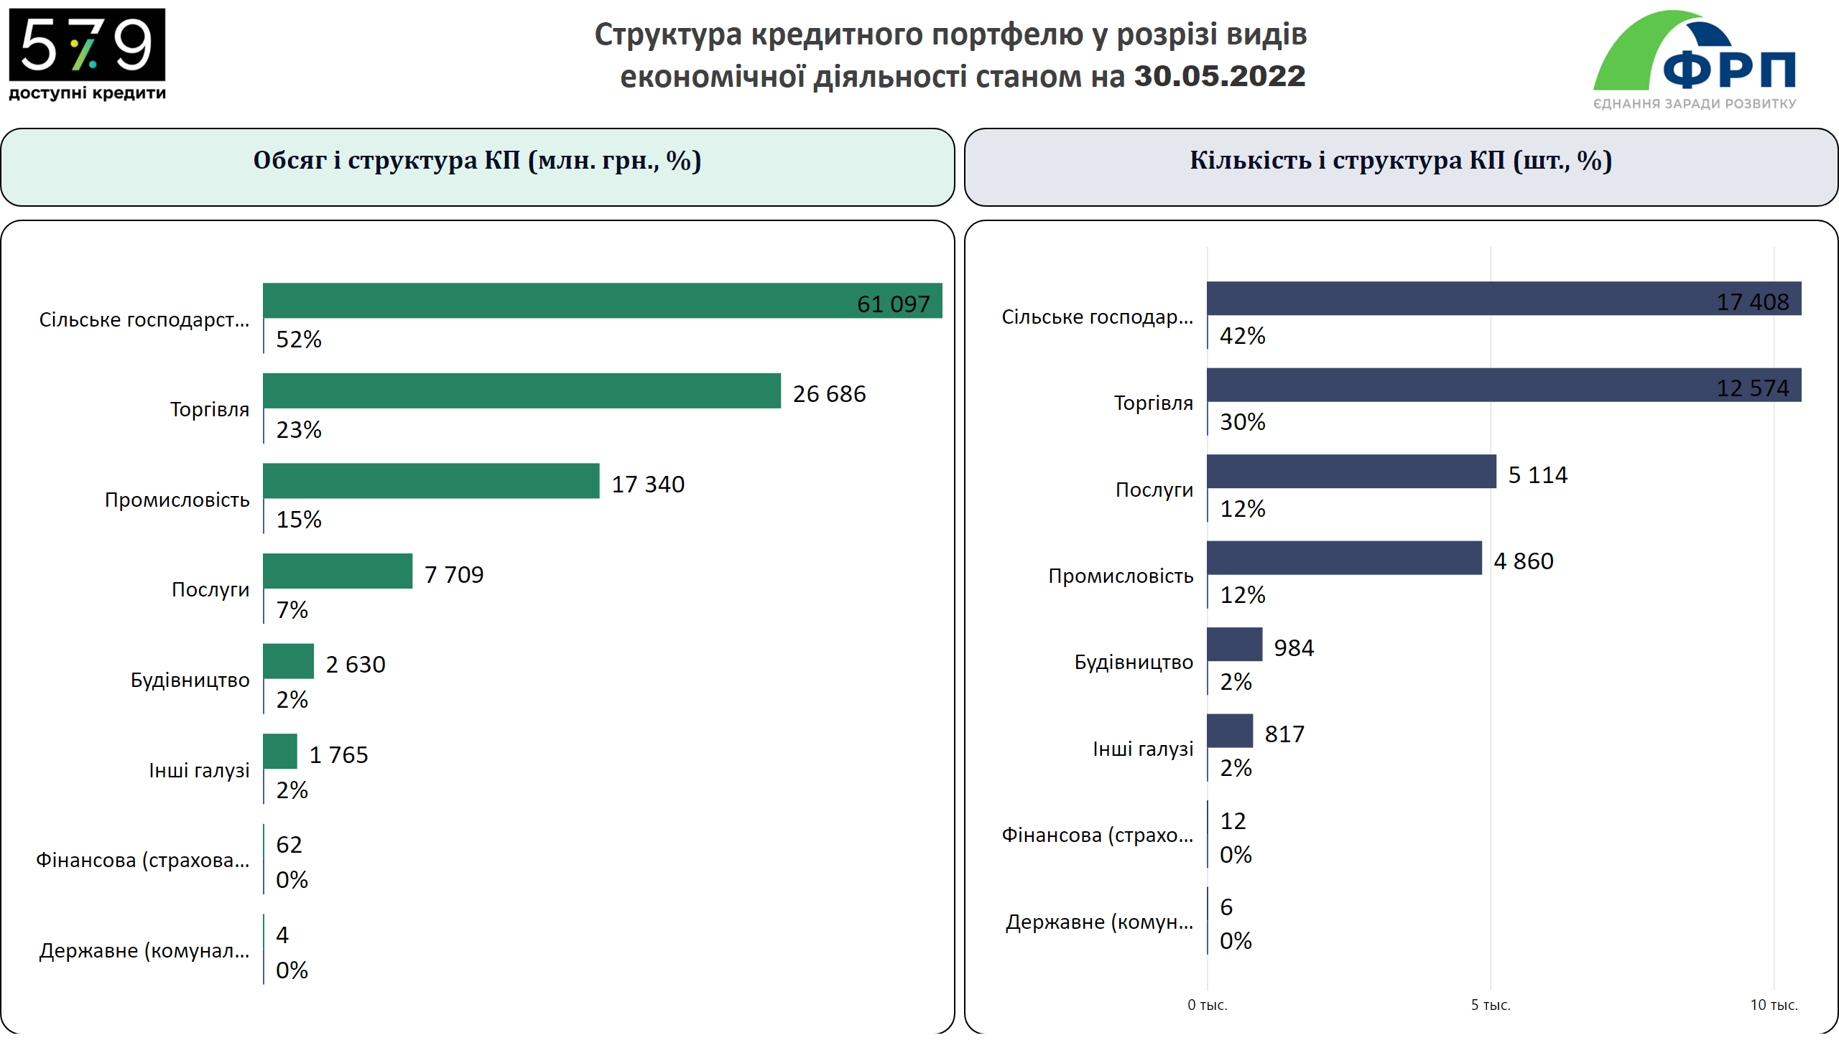
NEW_4-1_TO SITE_за галузями
Notes:
textbox
No alt text provided
slicer
No alt text provided
textbox
No alt text provided
clusteredBarChart
No alt text provided
clusteredBarChart
No alt text provided
textbox
No alt text provided
image
No alt text provided
30.05.2022
No alt text provided
image
No alt text provided

Slide 5
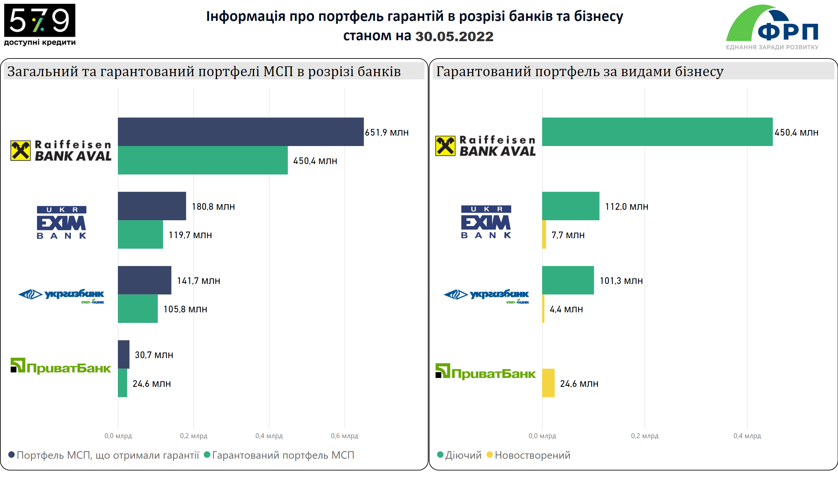
3_TO SITE_Слайд-10
Notes:
textbox
No alt text provided
slicer
No alt text provided
Загальний та гарантований портфелі МСП в розрізі банків
No alt text provided
Гарантований портфель за видами бізнесу
No alt text provided
image
No alt text provided
Privat_logo
No alt text provided
Privat_logo
No alt text provided
image
No alt text provided
image
No alt text provided
UGB_logo
No alt text provided
UGB_logo
No alt text provided
Aval_logo
No alt text provided
Aval_logo
No alt text provided
30.05.2022
No alt text provided
image
No alt text provided

Slide 6
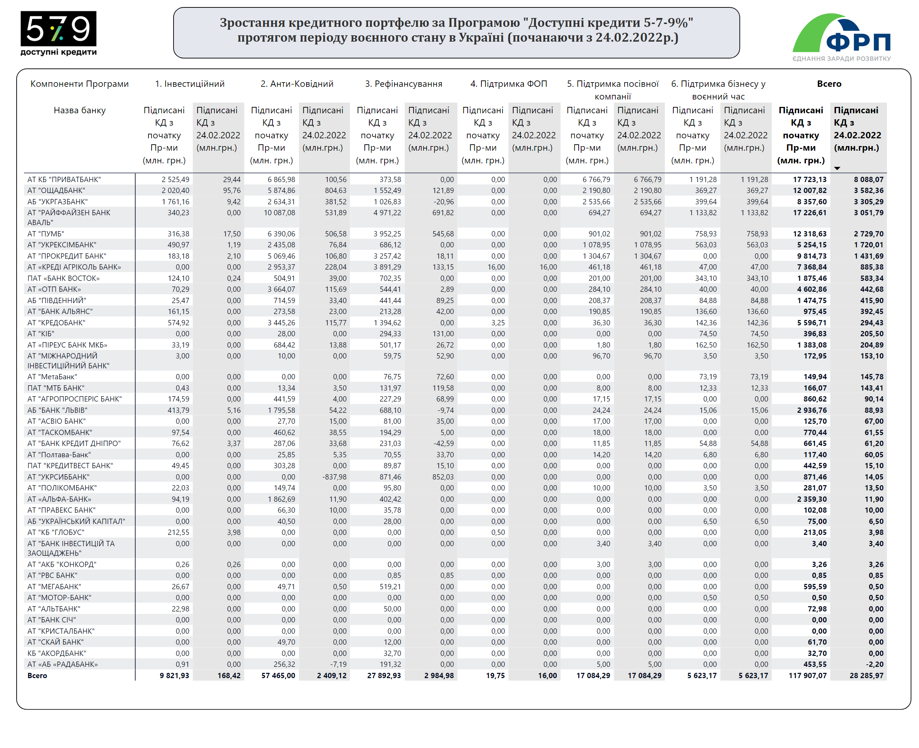
4_TO SITE_період війни
Notes:
textbox
No alt text provided
Table 3. Distribution by Goals & Banks, mln UAH (+ WtW growth)
No alt text provided
actionButton
No alt text provided
slicer
No alt text provided
slicer
No alt text provided
basicShape
No alt text provided
Image_Show Slicers
No alt text provided
image
No alt text provided
image
No alt text provided

