Slide 1
ENG_D-Summary
Notes:
multiRowCard
No alt text provided
Applications (uah)
No alt text provided
textbox
No alt text provided
FRP_logo
No alt text provided
Credits (uah)
No alt text provided
Applications & Credits by banks
No alt text provided
Average Credit (uah)
No alt text provided
10.01.2022
No alt text provided
Сума заявок (грн.)
No alt text provided
Applications distribution by market type
No alt text provided
Сума заявок (грн.)
No alt text provided
Credits distribution by market type
No alt text provided
Applications distribution by borrower type & credit goal
No alt text provided
Credits by regions
No alt text provided
Apps distribution by regions
No alt text provided
Applications distribution by type of borrower, mln uah
No alt text provided
card
No alt text provided
Applications by gender
No alt text provided
Applications & Credits by goals
No alt text provided

Slide 2
ENG_D-Summary (cont.)
Notes:
textbox
No alt text provided
FRP_logo
No alt text provided
Applications distribution by borrower type & mortgage
No alt text provided
10.01.2022
No alt text provided
Applications & Agreements by mortgage
No alt text provided

Slide 3
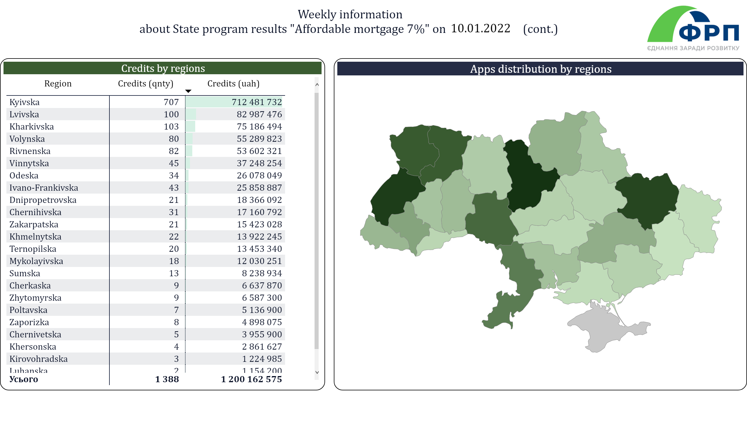
ENG_D-Summary (cont2)
Notes:
textbox
No alt text provided
FRP_logo
No alt text provided
Credits by regions
No alt text provided
10.01.2022
No alt text provided
Apps distribution by regions
No alt text provided

