Slide 1
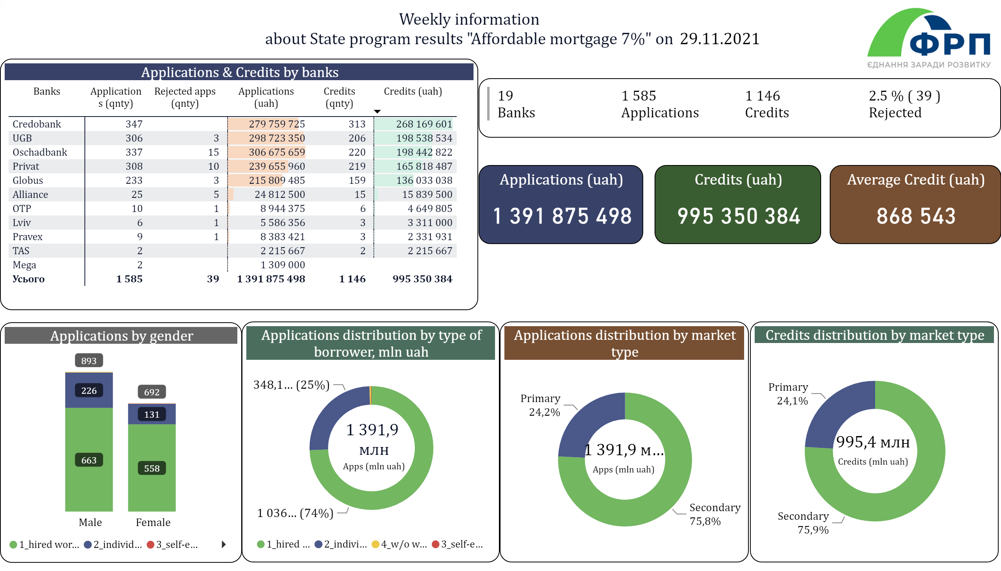
ENG_D-Summary
Notes:
Applications distribution by type of borrower, mln uah
No alt text provided.
Applications distribution by borrower type & credit goal
No alt text provided.
Apps distribution by regions
No alt text provided.
textbox
No alt text provided.
FRP_logo
No alt text provided.
Applications & Credits by banks
No alt text provided.
29.11.2021
No alt text provided.
Applications distribution by market type
No alt text provided.
Credits distribution by market type
No alt text provided.
Credits by regions
No alt text provided.
Applications & Credits by goals
No alt text provided.
Applications by gender
No alt text provided.
card
No alt text provided.
Applications (uah)
No alt text provided.
Сума заявок (грн.)
No alt text provided.
Сума заявок (грн.)
No alt text provided.
Credits (uah)
No alt text provided.
multiRowCard
No alt text provided.
Average Credit (uah)
No alt text provided.

Slide 2
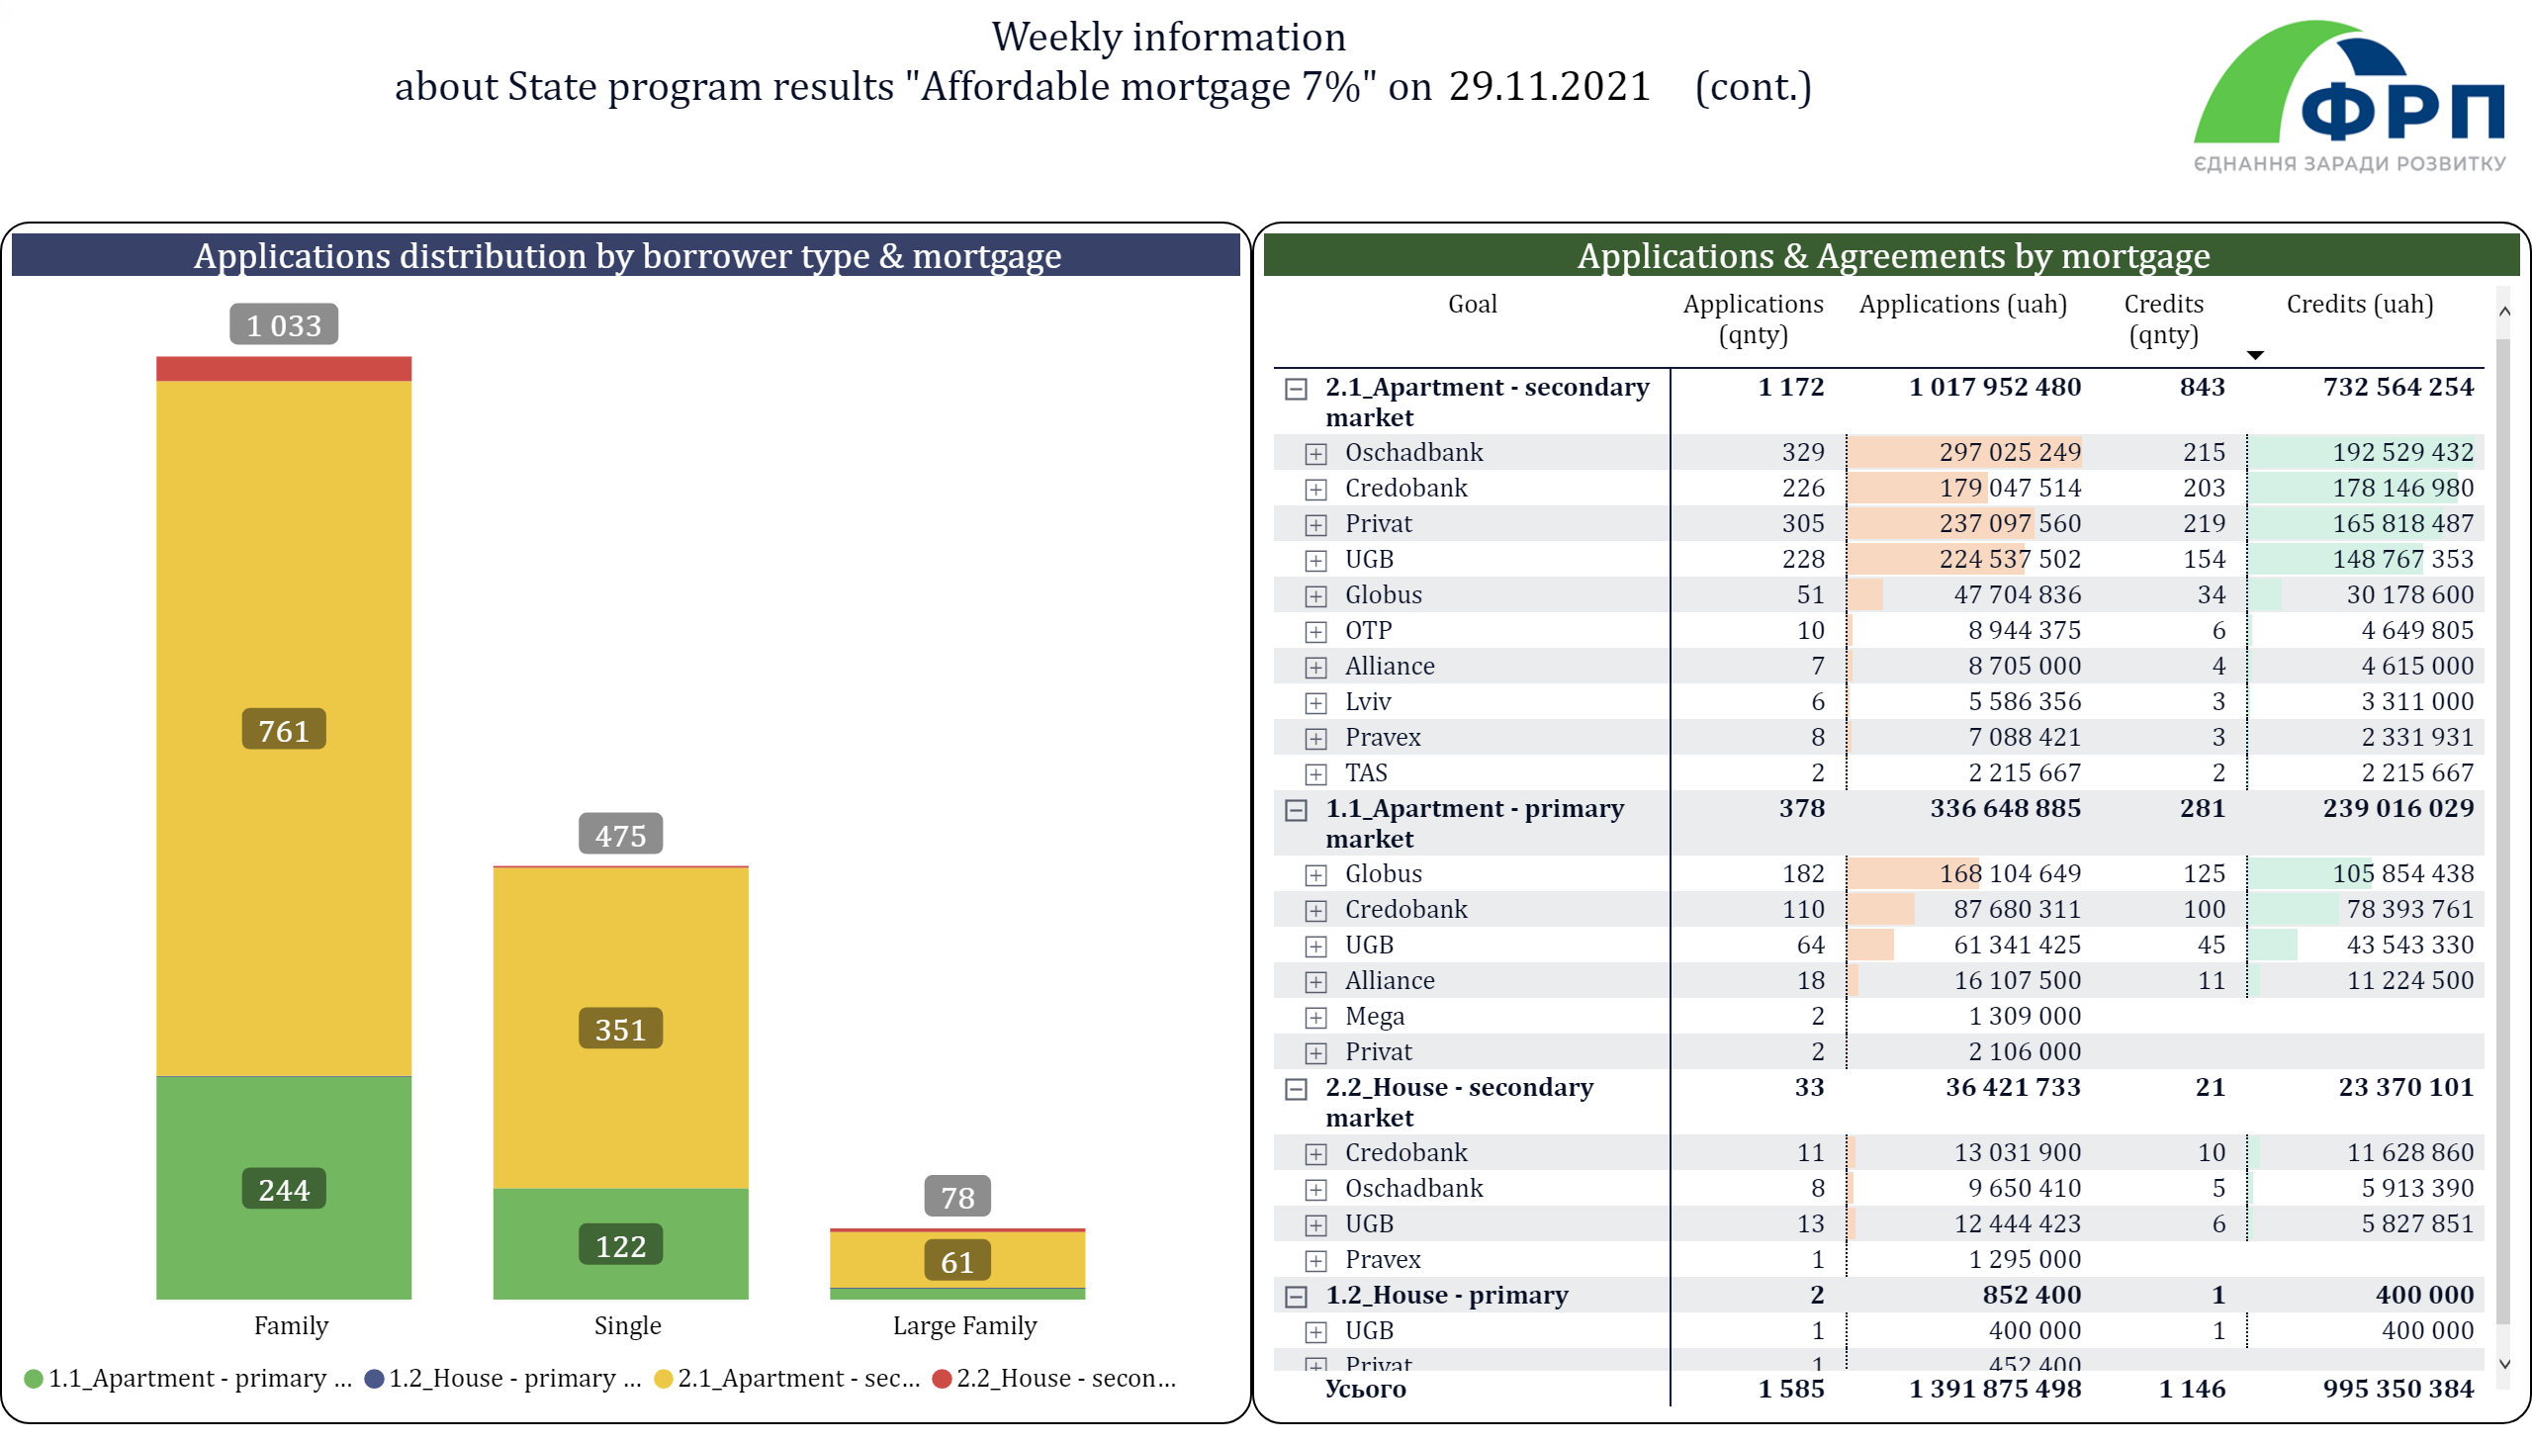
ENG_D-Summary (cont.)
Notes:
textbox
No alt text provided.
FRP_logo
No alt text provided.
29.11.2021
No alt text provided.
Applications & Agreements by mortgage
No alt text provided.
Applications distribution by borrower type & mortgage
No alt text provided.

Slide 3
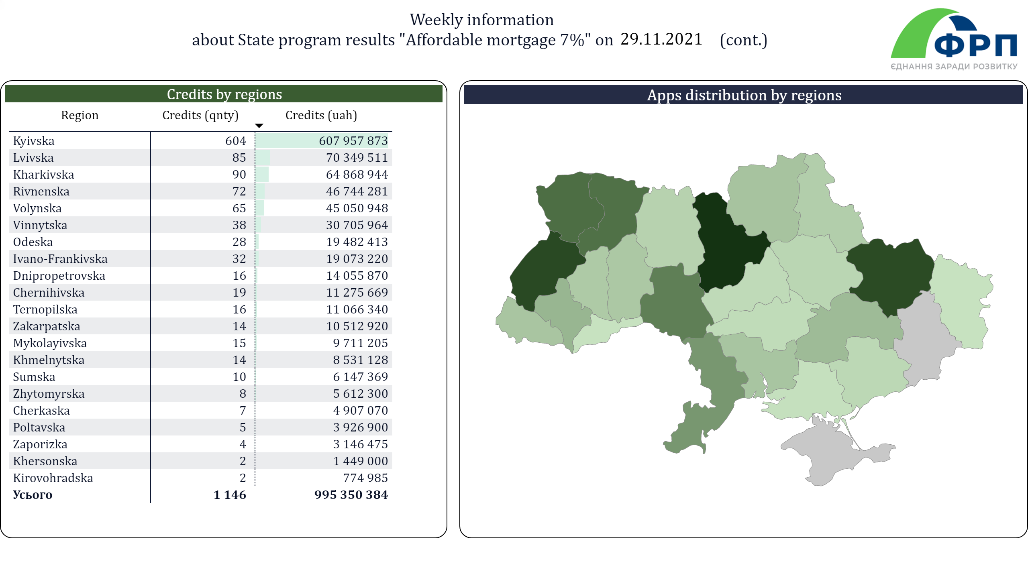
ENG_D-Summary (cont2)
Notes:
textbox
No alt text provided.
FRP_logo
No alt text provided.
29.11.2021
No alt text provided.
Credits by regions
No alt text provided.
Apps distribution by regions
No alt text provided.

