Slide 1
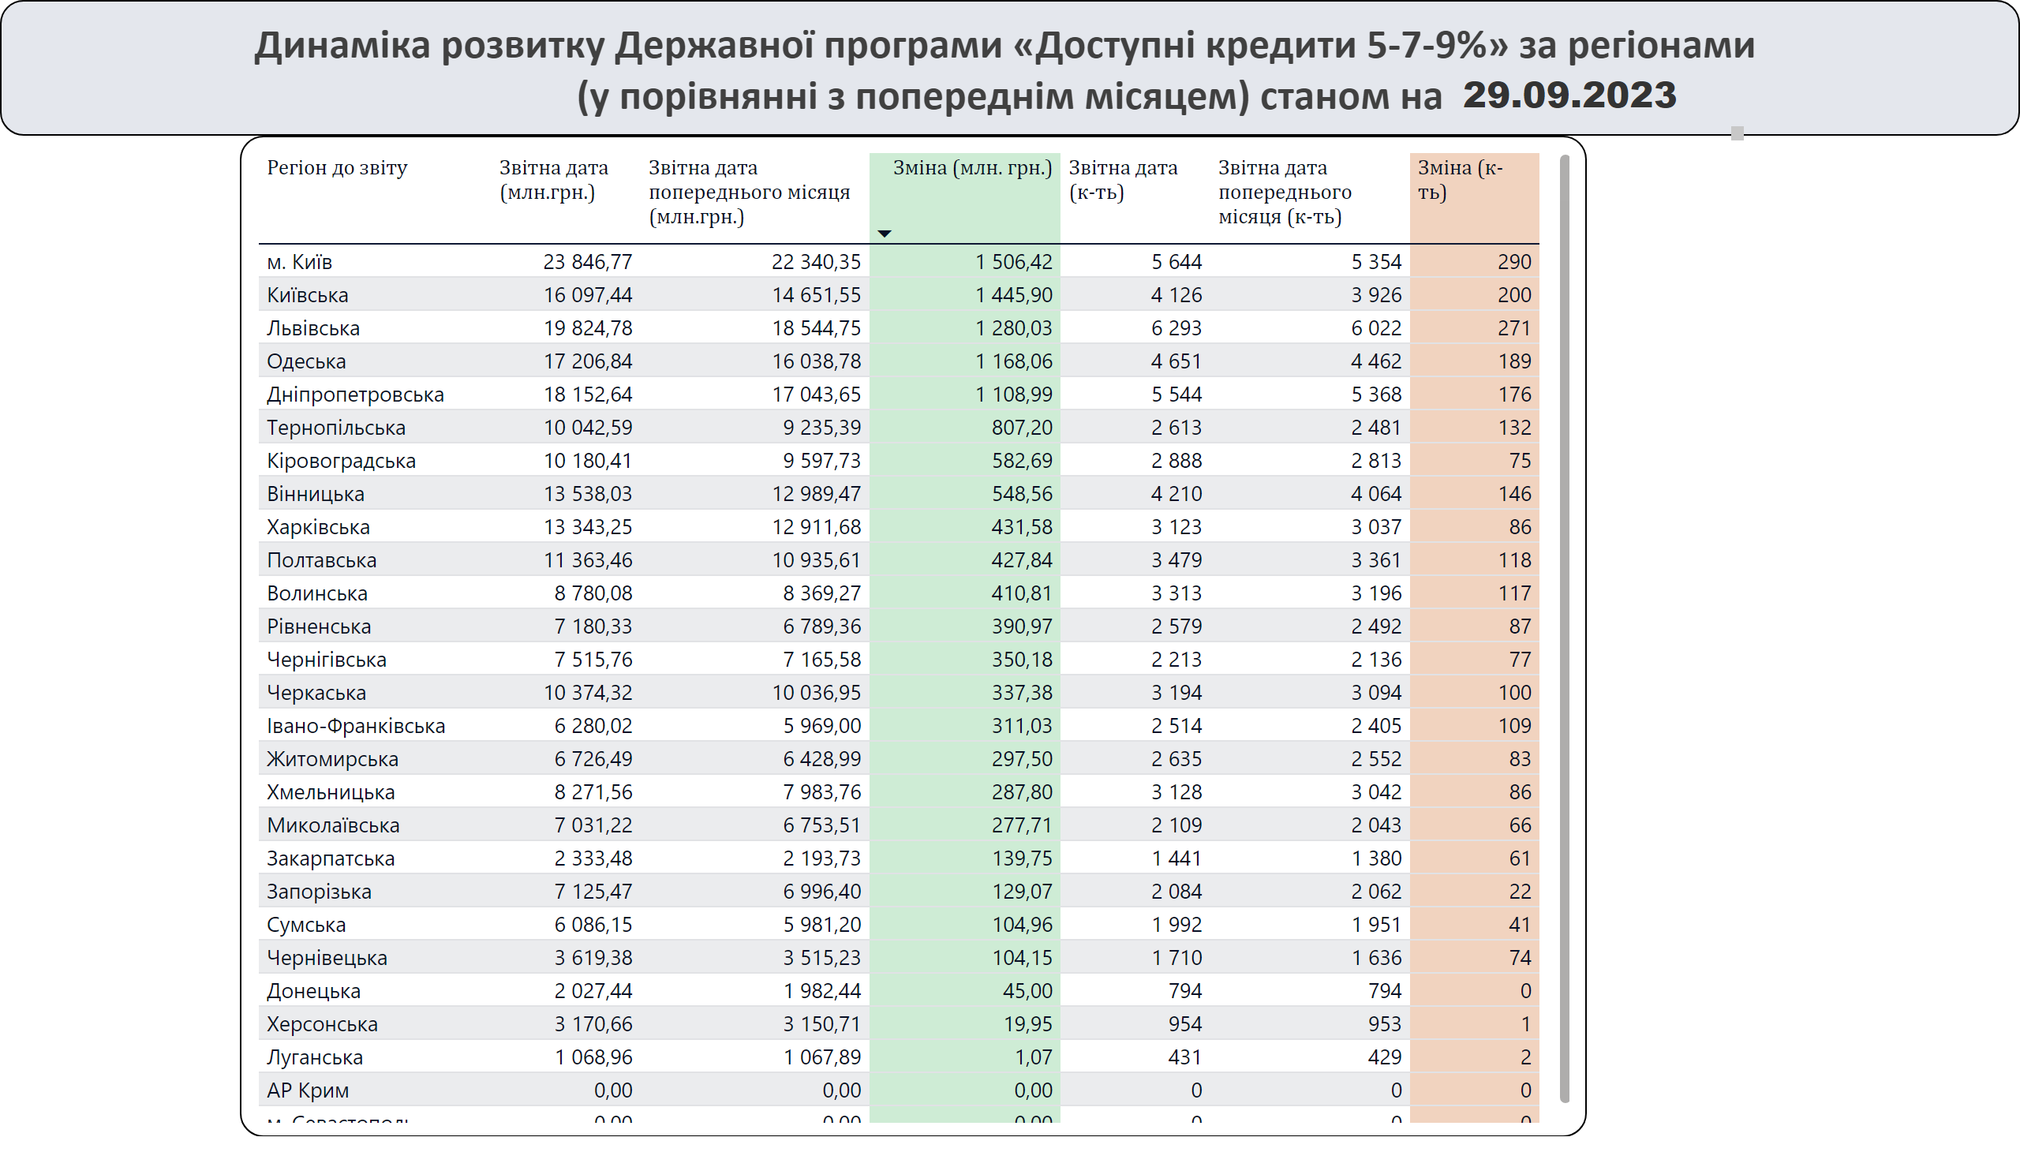
6_TO SITE_REGION - COUNT
Notes:
Dynamics by Regions
No alt text provided
slicer
No alt text provided
slicer
No alt text provided
tableEx
No alt text provided
29.09.2023
No alt text provided
textbox
No alt text provided

